Slide 1
Bonsai On A Budget
Alex Labram
April 2024
Walworth Garden

Slide 2
Learning Outcomes
Understand at a high level how a bonsai is produced
Understand at a high level what distinguishes good and bad bonsai
Know how to maintain a bonsai on a day-to-day basis
Experience the key activities of re-potting, pruning and wiring
Be aware of inexpensive options for further learning and practice

Slide 3
Bonsai: A Potted History
China
Daoist mysticism: recreation of magical sites in miniature
Penjing / Penzei = the art of miniature landscapes (pre 600AD)
Popular amongst Buddhist monks, and – later – aristocracy
Heavily impacted by Mao’s Cultural Revolution: seen as a bourgeois pastime
Japan
“Bonsai” (盆栽) = “tray planting”
First records c. 1200AD; known as Hachi-no-Ki (“potted trees” – also the name of a famous play!)
Heavy Zen / Chan Buddhist influence: beauty through austerity and perfection in imperfection (“wabi-sabi”)
Increasingly popular from 1800s onwards; term “bonsai” adopted
Development of distinct styles (dramatic archetypes)
Exported to West (USA, Europe) from 1960s onwards, in parallel with Japan’s “economic miracle”

Slide 4

Bonsai: Art & Science
Bonsai: a small tree that appears to be a scaled-down large tree.
Good bonsai practice is:
Authentic - makes you think “tree”
Dramatic – makes you think “TREE”
Pragmatic – doesn’t make you think “dead tree”…

Slide 5
Pragmatism 1
How Not To Kill Your Tree

Slide 6
What Kind Of Tree Is A “Bonsai”, Anyway? (Trick Question Alert!)
“Tree”: a woody plant that can reach 20ft on a single unsupported trunk
Almost any tree species can be trained into a bonsai; many smaller plants can too
Requirements for bonsai-ing:
Vascular plant (no mosses!)
Woody growth / “lignification” (no daisies!)
Secondary growth of trunk (no palms!)
Free-standing (no lianas!)
Deep roots (no grasses!)
Desirable features
Attractive / interesting species
Small or pinnate leaves
Long-lived
Reasonably fast-growing
Easy to maintain / shape
“Honorary” bonsai species
Woody climbers: ivy, wisteria, honeysuckle
Succulent / fleshy: dwarf jade, geranium
Chrysanthemum

Slide 7
I Had One Once, But It Died What A Bonsai Needs To Survive
Environment
Indoor vs Outdoor
Water!!!!!
Back-of-hand test
Three passes to penetrate fully…
…Or dunk to edge of pot
Allow to drain fully!
Light
Heat
Dormancy
Airflow
Pest Control
Animals: spider mites
Plants etc: pearlwort, liverwort, wood sorrel, pennywort, nostoc
Caution: environmental issues!
Fertiliser
“Balanced”: roughly even NPK
Organic => micronutrients
Caution: environmental & ethical issues!
Bonsai are far harder to keep alive than most common pot plants!

Slide 8
Authenticity & Drama
Thinking Like A Tree (That’s Seen Some S**t)

Slide 9
Silvics 101 What Shapes A Tree
Sun
Airflow
Gravity / load
Shade
Animals

Slide 10
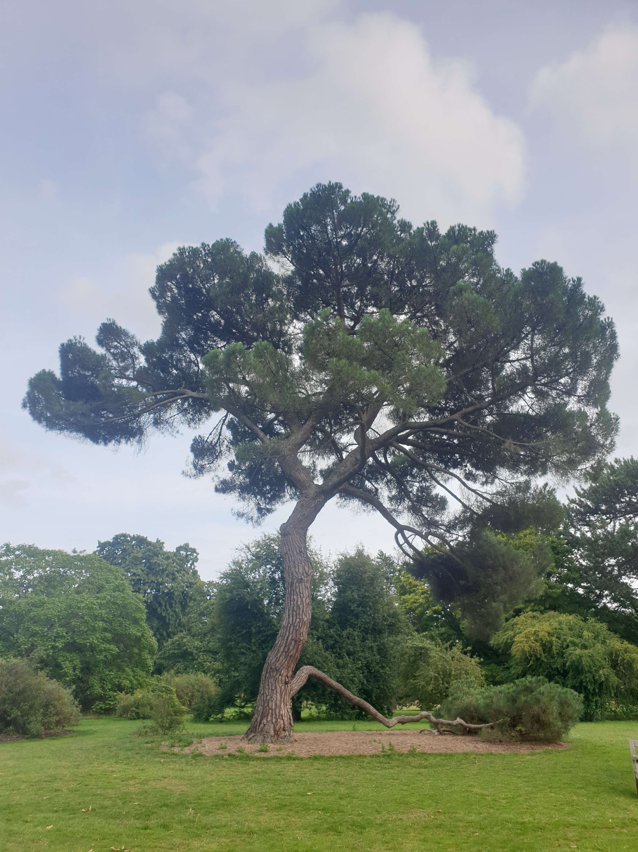
Authenticity & Age What Makes A Tree Look Mature?
Canopy shape
Rounded triangle
Composed of rounded-triangle “pads” (for species that don’t back-bud readily)
Trunk & branch behaviour
Short inter-node distance
“Ramification”: fractal splitting of branches
“Square-cube law”: big tree = heavier load = more curvature
“Ruptures”: jagged direction changes
Texture
Bark
Dead-wood: advanced bonsai topic!
Taper
“Nebari” (根張り) = root flare
Trunk & branch flare: base to apex / tip
Trunk-to-branch ratio

Slide 11
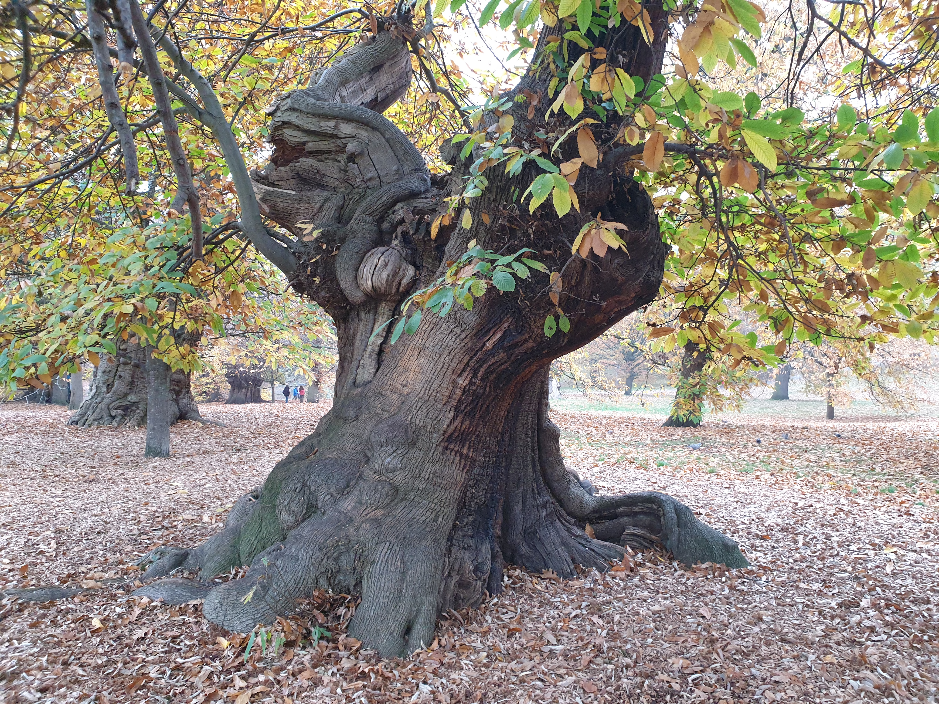
Drama & Perspective What Makes A Tree Stand Out?
Taper (again!)
Taper appears stronger from viewpoint at base of tree
Pot: picture-frame for tree
“Heavy” earthenware vs “light” glazed
Depth ≈ trunk thickness; width ≈ 2/3 canopy height (tall tree) or width (wide tree)
Style: heavy vs light, plain vs ornate
Use of negative space
…Often justified as effect of wind-flow or trunk death
Scaled-down decorations
Moss “grass”, accent plants, rocks (“suiseki”)
Well-defined “front”
Style is firmly established
Sense of strength or movement captured
Clear view of lower trunk
No crossed branches
Tree’s “centre of mass” is in middle of pot

Slide 12
Flaws What Gives The Game Away?
Obvious tool marks
…Including wire scarring
Excessive symmetry
…Especially handlebar branches
Asymmetry is a common theme in Japanese gardening!
“Reverse taper”
Unusual “habit” for species / genus
Google for pictures of wild tree to get ideas!
Frequently ignored: small shrubs portrayed as large trees, boringly-shaped species, pads on back-budding species etc
Clean of dead leaves and (unwanted) deadwood
“Weak” branches
Suckers
Congested nodes
Under-slung / elbow branches
Lack of clear “leader” (dominant trunk / branch)

Slide 13
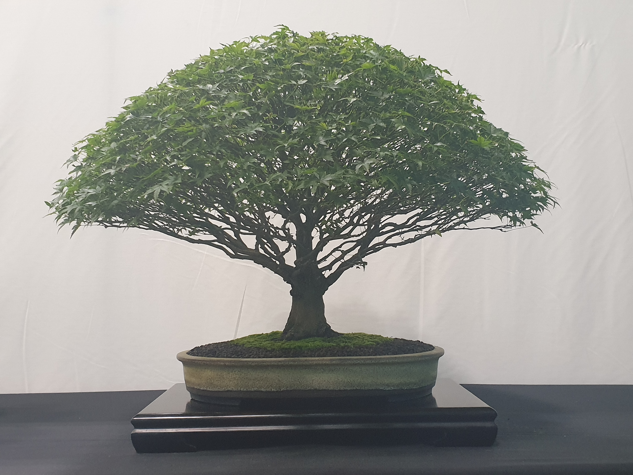
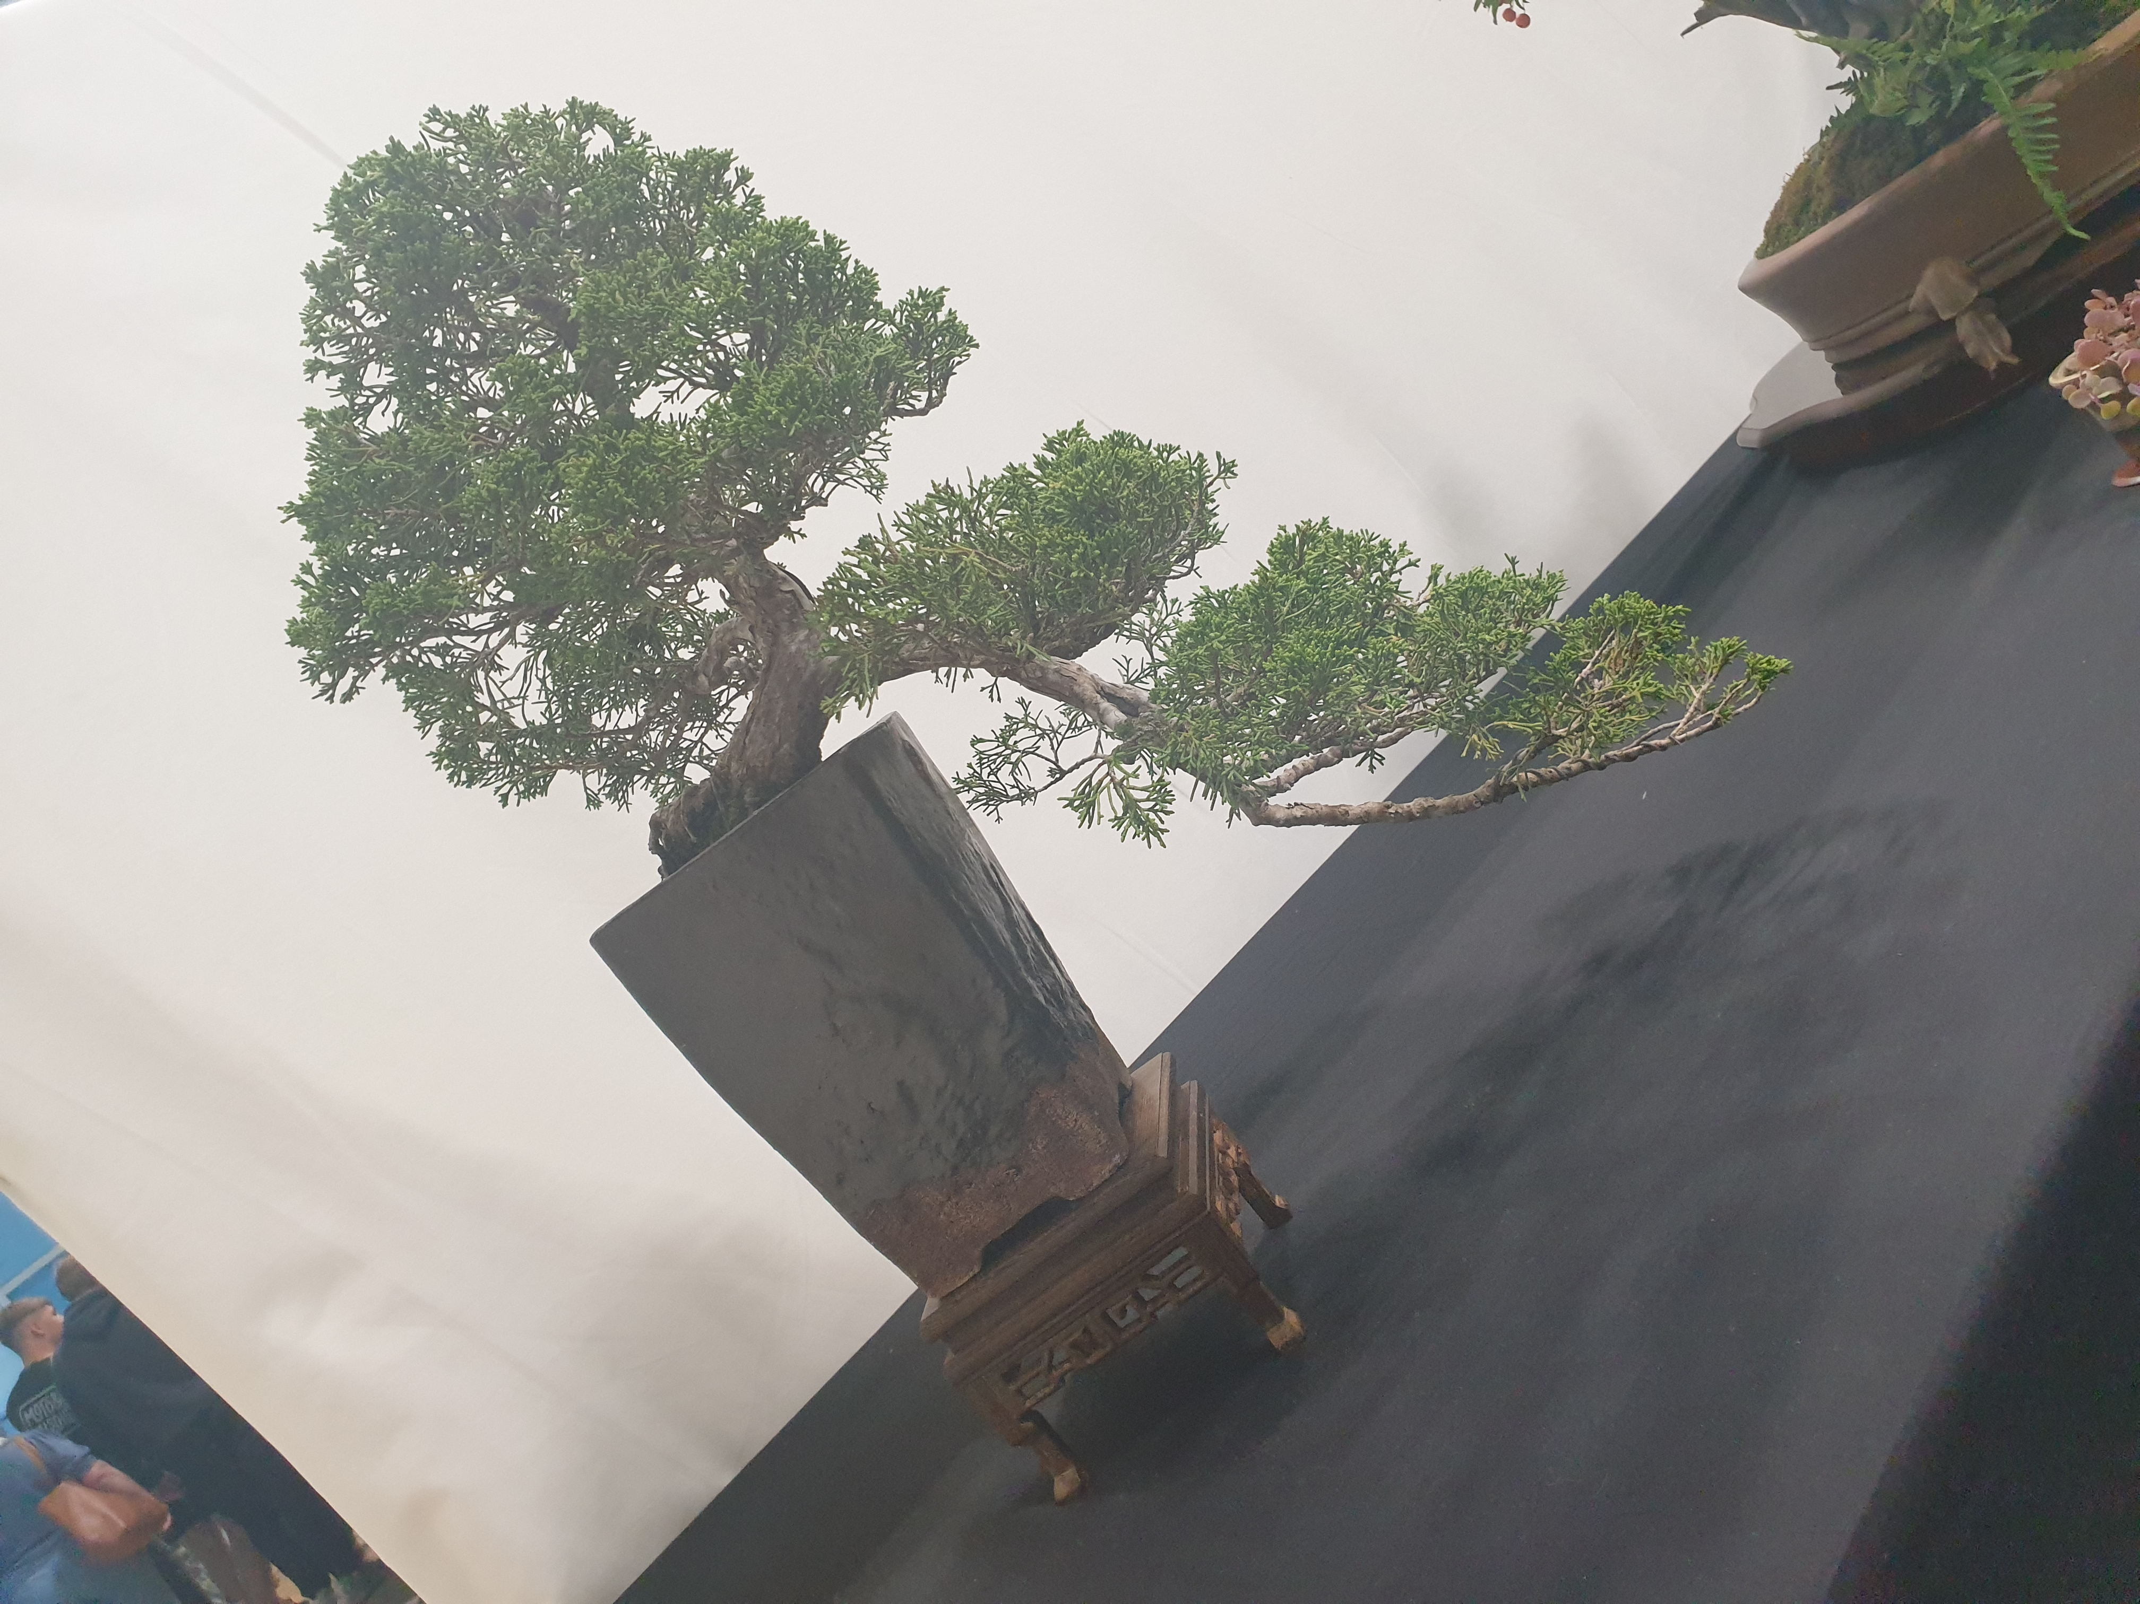
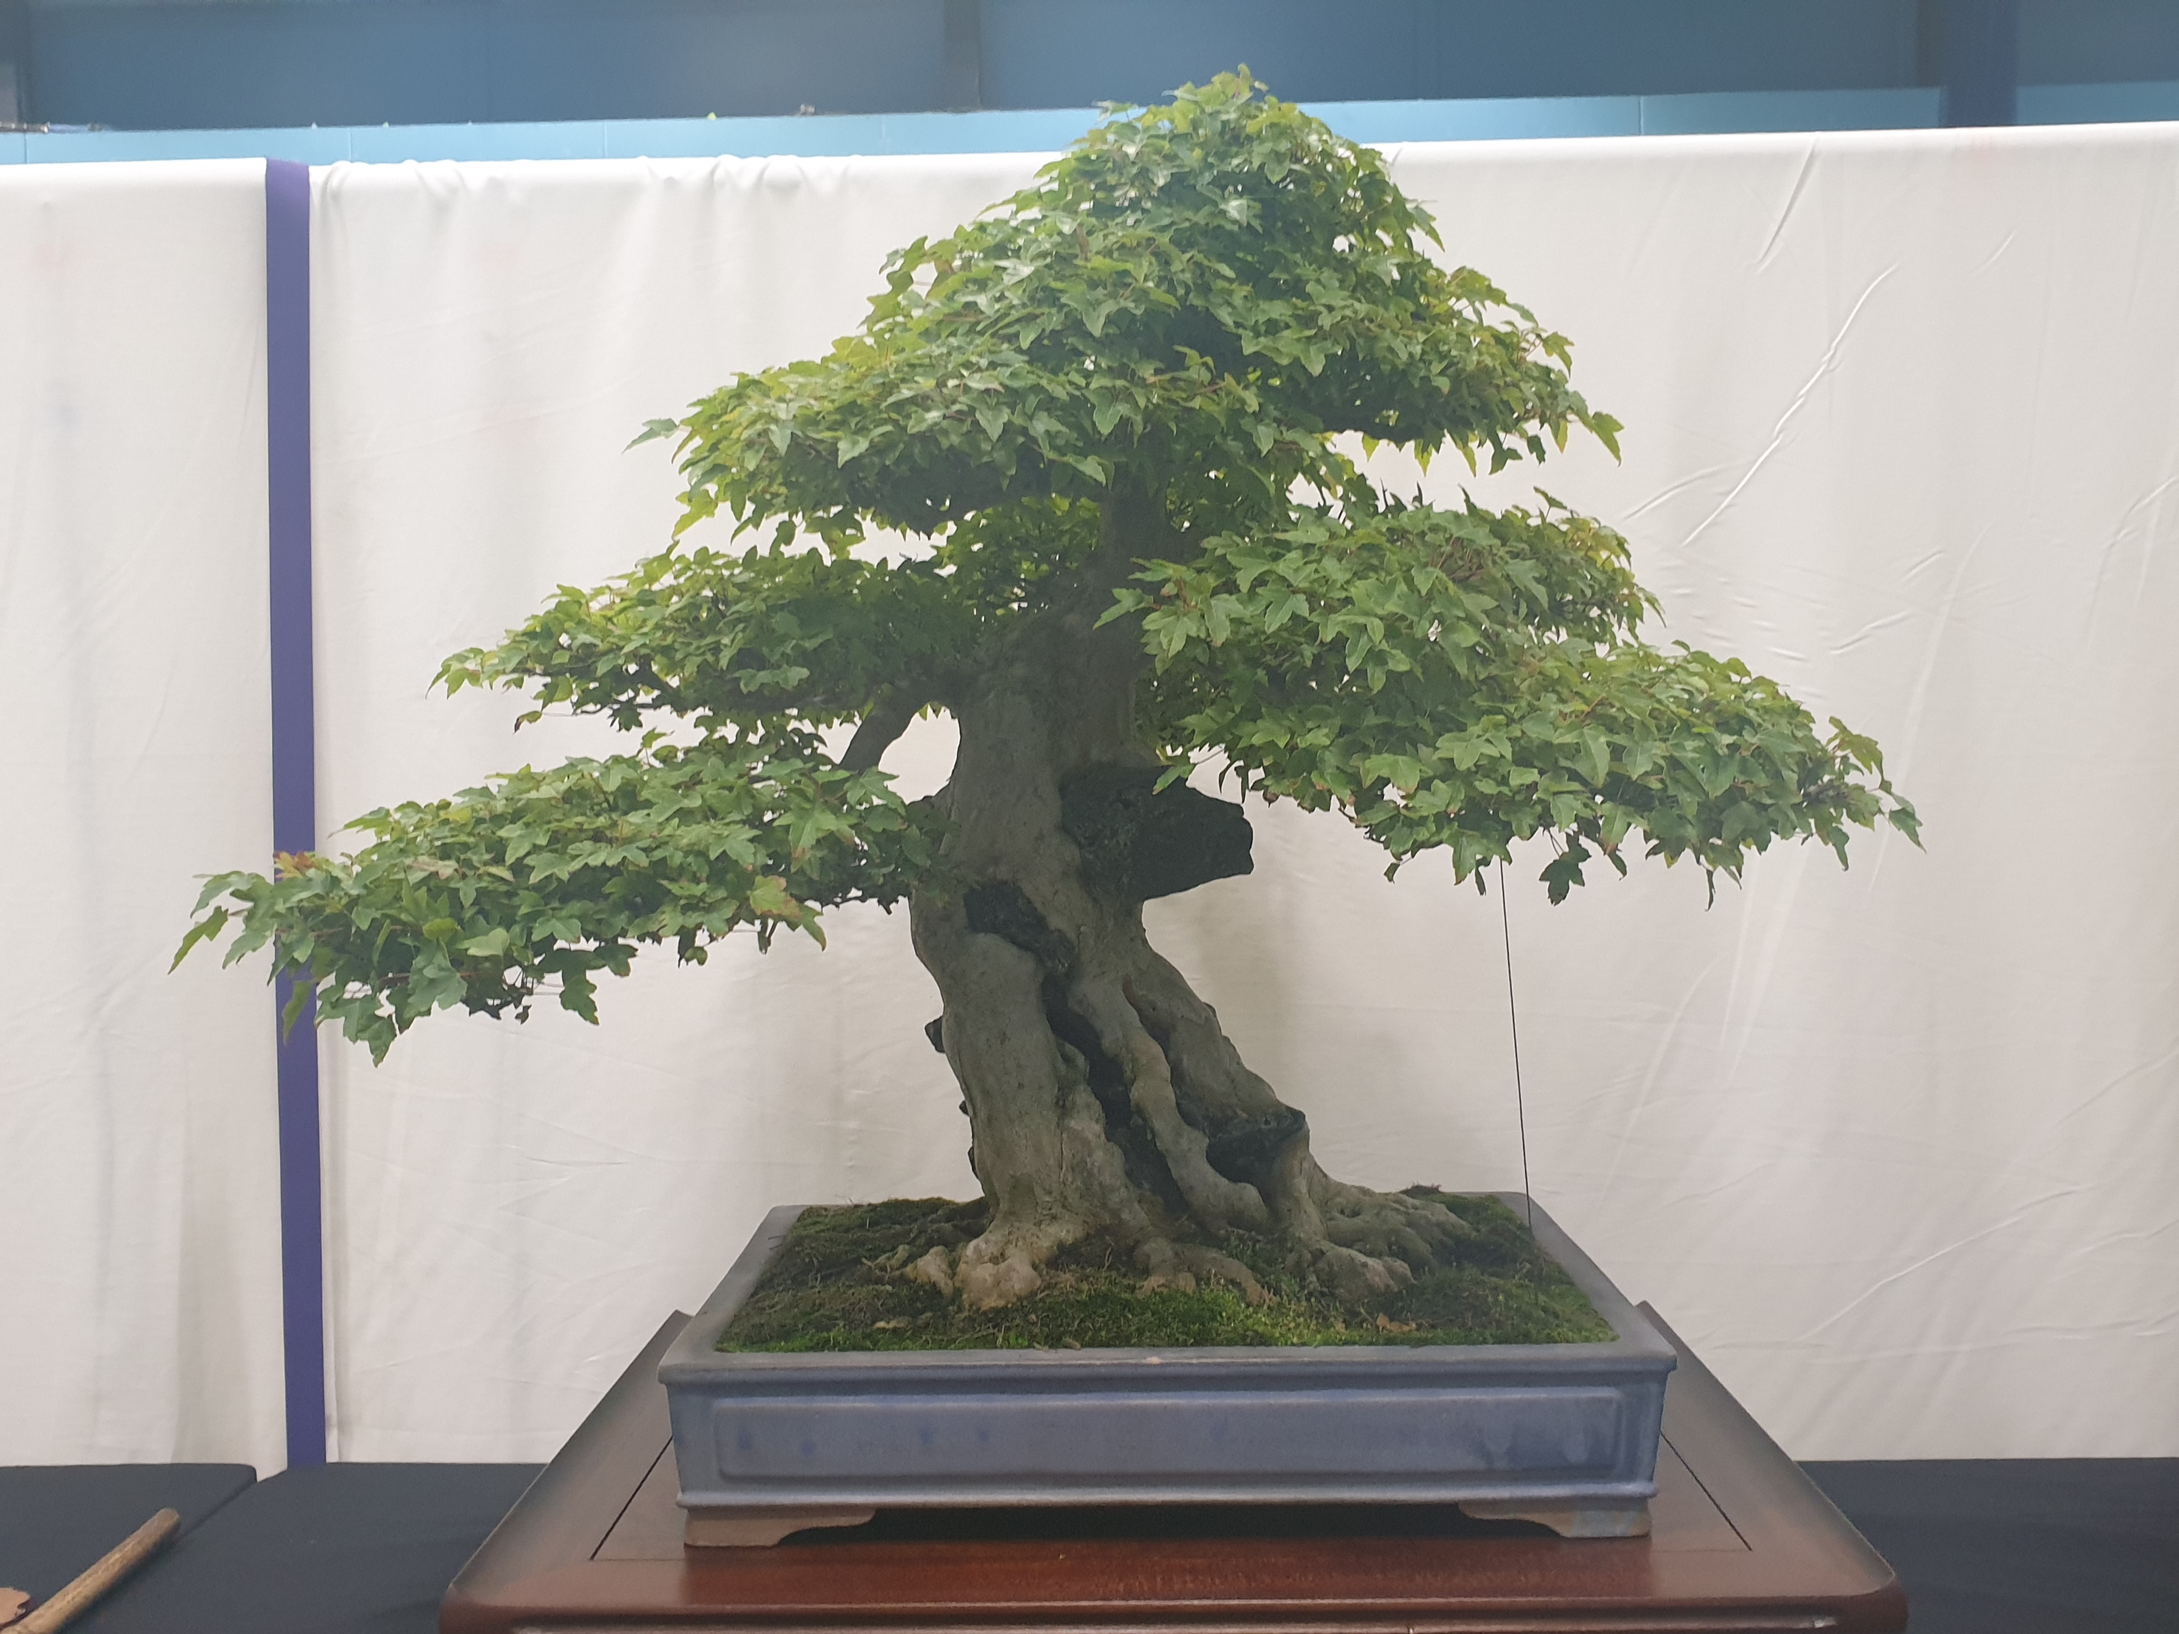
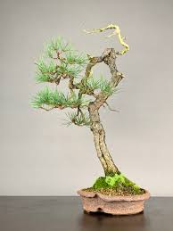
Bonsai Styles
Formal Upright
Cascade
Image
Strong, proud, “yang”
Pot: unglazed earthenware; simple shape; bulging
Can be hard to develop taper
Flowing, falling
Pot: deep to make space
“Half-cascade” runs to base of pot; “cascade” goes below that
Informal Upright
Literati
Image
Relaxed, elegant, “yin”
Pot: glazed; fluting; flowery
Broad range of possible shapes
Basically the default style!
Solitary, melancholy, bleak
Trunk: bare, ruptured, calligraphic
Pot: small to emphasise plant’s extravagant loneliness
Style derived from woodcuts in classic Chinese drawing guide

Slide 14
Pragmatism 2
Making Life In Miniature

Slide 15
Bonsai Lifecycle
Sources
Training
Refinement
Slow
Seeds
Cuttings
Fast
Garden centre seedlings
Scavenging
Ready
Nonsai
Garden centre mature trees
Yamadori
Exhibition
On-boarding
Grow out
Re-pot
Prune
Wire
Cut back
Dead ☹
Major intervention

Slide 16
Repotting
Prepare pot
Pick a (tentative) pot
Scrub clean
Staple mesh over holes
Add guy wires
Prepare tree
Remove from pot
Clean off soil surface
Dig down to expose nebari
Dig up / in to define root-ball
Untangle lateral roots where poss.
Clear growth from lower trunk
Insert tree into pot
Add shallow layer of soil to base
Place root ball in pot
Pack soil around and over root ball
Compress soil to “brownie” hardness
Pull guy wires over root ball and tie off
Cover with grated, rehydrated sphagnum
Compress sphagnum
Sprinkle with grated acrocarpous moss

Slide 17
Pruning Broadleaf Trees Playing In Easy Mode
Allow to
grow out
Conditions
Can handle loss of mass
Back-buds readily
Leaves may be simple or compound
Leaves may be alternating or opposite
Philosophy
Minimal wasted growth
Each branch should have “two heirs and a spare” (at least)
The spare is a “sacrificial” branch: it can be removed later, once the chosen “heirs” are established, or allowed to grow out to thicken the parent branch
Repeat for each new branch
Pinch off tip
Wait for buds to burst
Wait for buds to burst
Cut back
to 3 nodes*
* Or 2 nodes (4 buds) for opposite leaves

Slide 18
Pruning Conifers Getting trickier
UNFINISHED
Needle-bearing / pine-like
Preconditions
Back-buds weakly from old growth
One or more needles per bundle
Philosophy
Green growth should form “pads”
Conditions

Slide 19
Wiring
UNFINISHED

Slide 20
Thanks For Attending!

Slide 21
H1 H2

Slide 22
Appendices
Miscellaneous Technical Notes

Slide 23
Woody Plants: A Family Tree Evolution From A Bonsai Pruner’s Perspective
Prune as:
Broadleaf
Needley conifer
Spiky / scaly conifer
Special case
B
N
S
!
Vascular plants
B
Gymnosperms (“Naked Seed”)
Angiosperms (“Covered Seed”)
Magnoliids
!
Gingko
B
B
Pinaceae (“Pine-like conifers”)
Cupressaceae (“Cypress-like conifers”)
Asterids
Rosids
N
Pine
!
Yew
“True” Cypress
S
Ash
(Crab) Apple
Oak
N
B
S
Spruce
Redwood
Juniper
Elder
Elm
Maple
N
S
S
“True” Cedar
Sugi
“False” Cedar
Rhododendron
Prunus: Cherry, Plum, Apricot, etc
Lime
N
Beech
Larch
Azalea

